Slide 1
Scientific Research & Literature
Predicting Company ESG Ratings from News Articles Using
Multivariate Timeseries Analysi

Slide 2
Overview of different Methods/ Common techniques
Regression analysis (linear, multi linear, polynomial, logistic)
Statistical analysis (mean, median, mode, etc.)
Association analysis
Sentiment analysis/ opinion mining
Hypothesis testing
Clustering analysis
Decision trees
Random forest (Ensemble Learning)
Classification

Slide 3
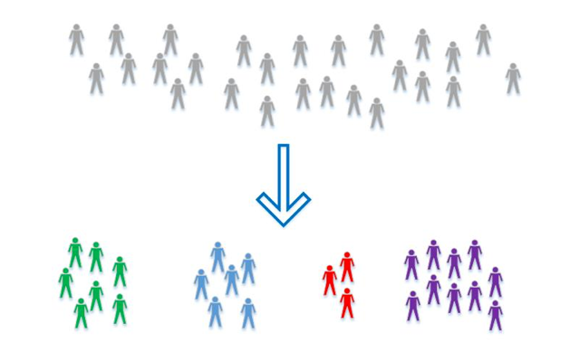

Classification
Attempts to classify new observations based on what it learned from the input training data
Supervised learning
Propensity modelling
Finance, healthcare, customer churn
Positivism
Mixed-Methods

Slide 4

Classification Strategies: Experiment
Layer 3 of Research Onion
Experiment:
No one model that works best for every problem
Experiment multiple models and find one that works best for a particular problem (Cai, 2014).
Statistically analyze results
Archival Research:
Classification is about explaining the past and predicting the future
Exploring past data or existing datasets
To predict future values

Slide 5
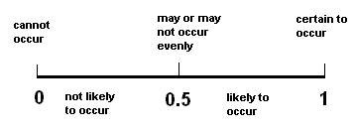
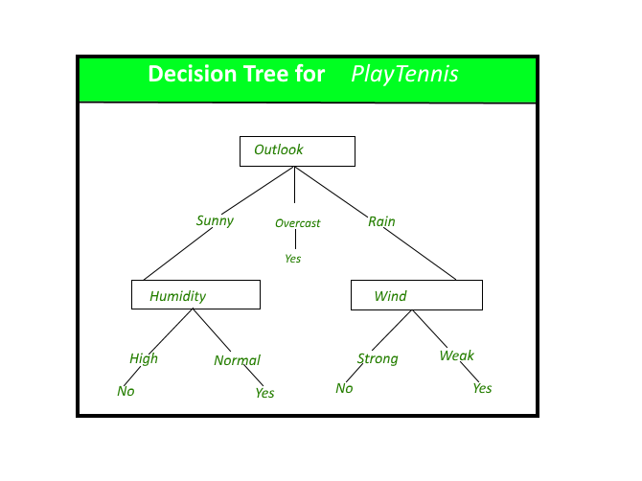
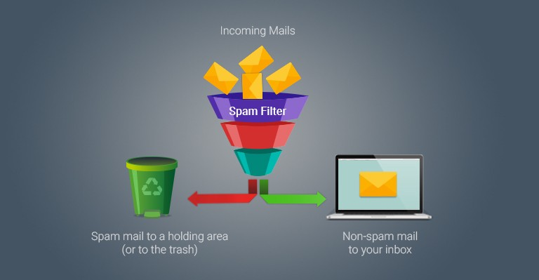
Classification Data Collection, Analysis Methods and Tools
Method: Experiment - Correlation
Logistic regression
Classification models
Analysis: Statistical
Tools:
Decision trees
Random forests
SVM
K-nearest neighbors
ANN
Naive Bayes

Slide 6
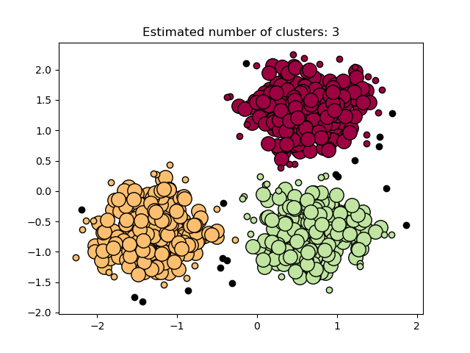
Clustering
Clustering is the process of partitioning a set of data (or objects) into a set of meaningful sub-classes, called clusters (Kaur & Kumar, 2016).
Unsupervised Learning
K- Means and Mean –Shift clustering
Good at creating quick logical groupings
Fraud detection, groupings of animals or plants, weather patterns
Useful tool as pre-cursor to classification

Slide 7
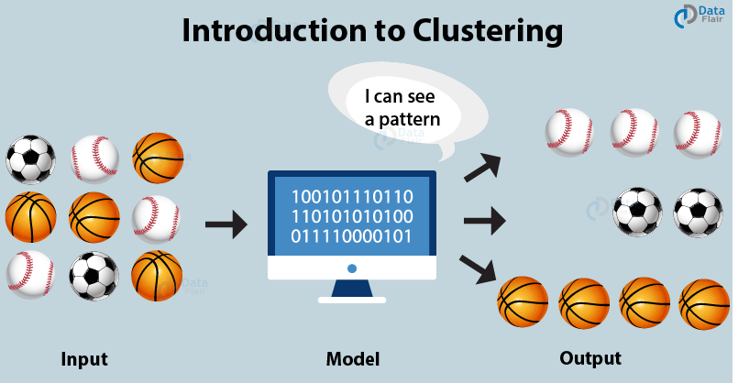
Clustering
Layer 6 of research onion
Method: Experiment- Correlational
Inductive
Analysis: Statistical
Tools : Machine Learning, SAS Enterprise Miner, Cluto
Quantitative or qualitative

Slide 8
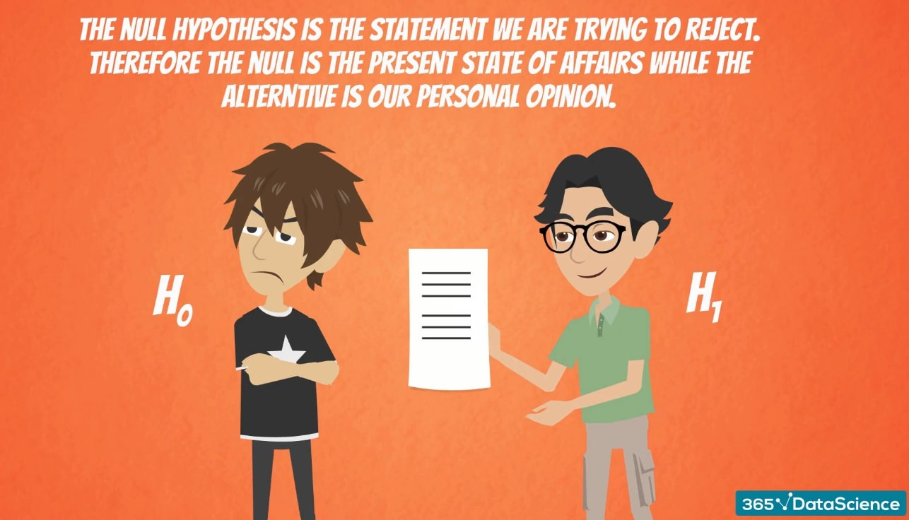
Hypothesis Testing
Method of testing a new theory
Relies on gathering information to support the new theory
Purely deductive approach
Designed for quantitative data – perhaps following qualitative research

Slide 9


Hypothesis Testing
Strategies
Experiment
Surveys
Archival research
Common tools
Forms/questionnaires
Statistical software

Slide 10

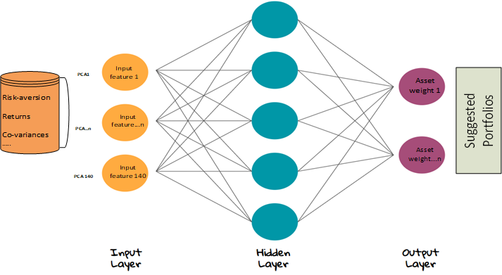
ANN in ROBO Advisory Visualizing in the inner layers of the neural network? (Senko, 2019)
Philosophy: Positivist epistemological
Approach: Deductive
Strategy: Experiment
Choice: Mixed-methods
Time-horizon: Cross-sectional
Data Collection and Analysis:
Experiment: Correlation
Analysis: Statistical and Sensitivity
Tool: Artificial Neural Network

Slide 11
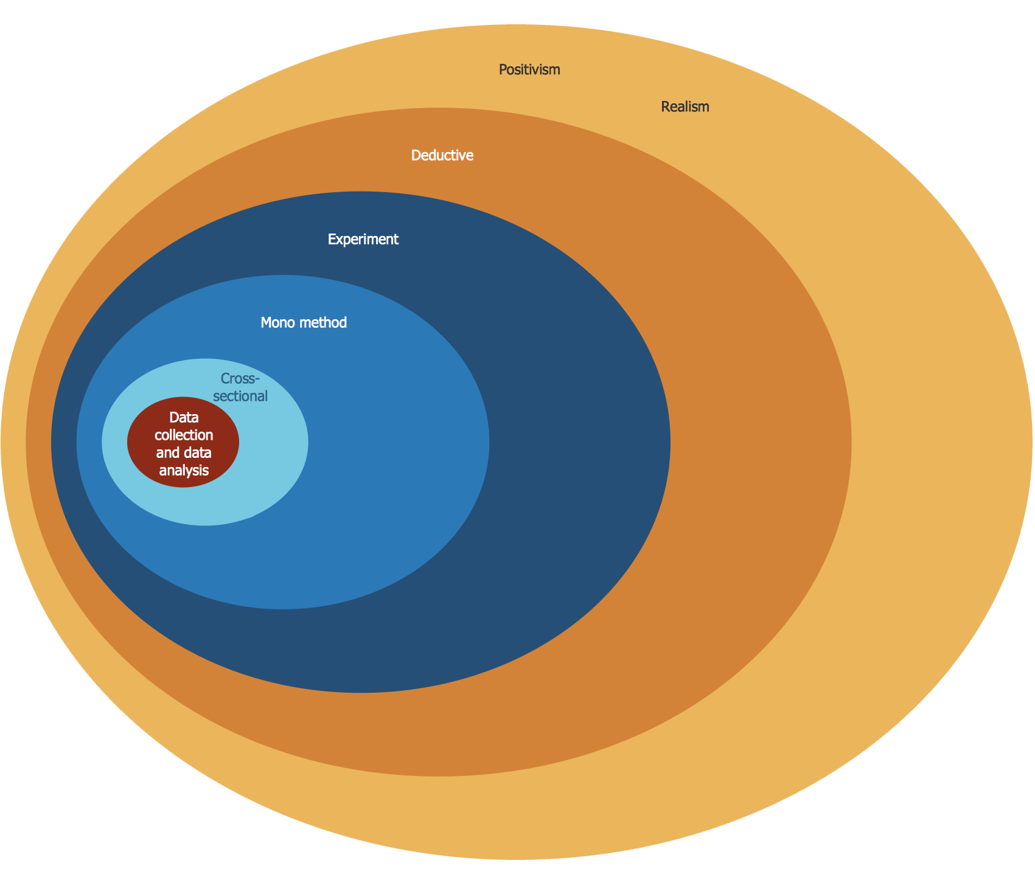
Research Method - Benchmarking
Epistemology
Concerns ‘hard’ data rather than opinions
Positivism & Realism
Quantifiable, reproducible results
Deductive
Confirm hypothesis through
quantitative research
Experiment
Reproducible results
Statistical data
Mono-Method
Quantitative
Cross-sectional
Data Collection & Analysis
Profiling tools
Comparing results to draw a conclusion
https://www.conceptdraw.com/samples/management-stakeholder-onion-diagrams

Slide 12
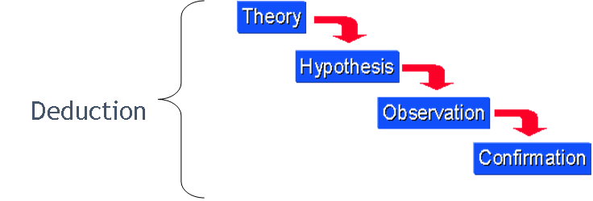

Slide 13
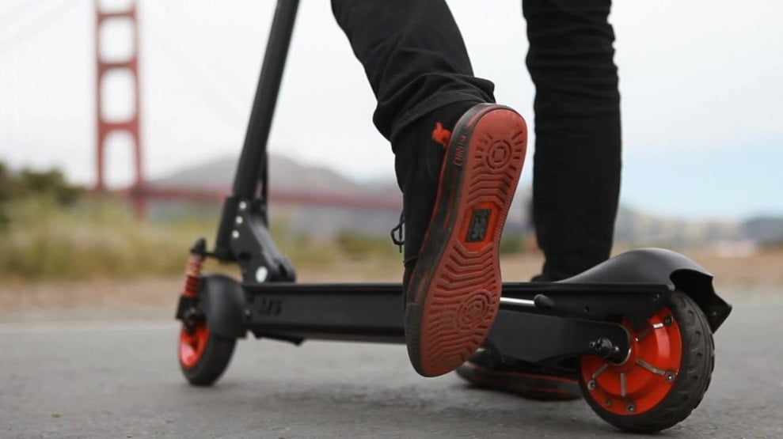
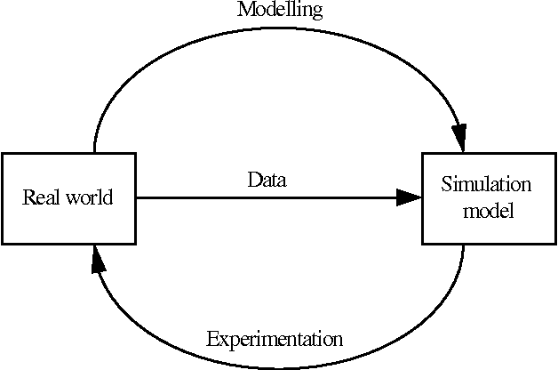
Are riders of electric two-wheelers safer than cyclists in collisions with motor vehicles? (huang, zhou, koelper, li, & ni, 2020)
Philosophy: Positivist epistemological
Approach: Deductive
Strategy: Experiment
Choice: Mixed-methods
Time-horizon: Cross-sectional
Data Collection and Analysis:
Experiment: Formal Modelling
Analysis: Statistical
Tool: Simulation Package - MADYMO

Slide 14


Can clustering help to identify health insurance fraud? (Peng et al., 2006)
Philosophy: Positivist epistemological
Approach: Inductive
Strategy: Experiment
Choice: Quantitative
Time-horizon: Cross-sectional
Data Collection and Analysis:
Experiment: Correlation
Analysis: Statistical
Tool: Machine Learning- SAS Enterprise Miner, Cluto

Slide 15

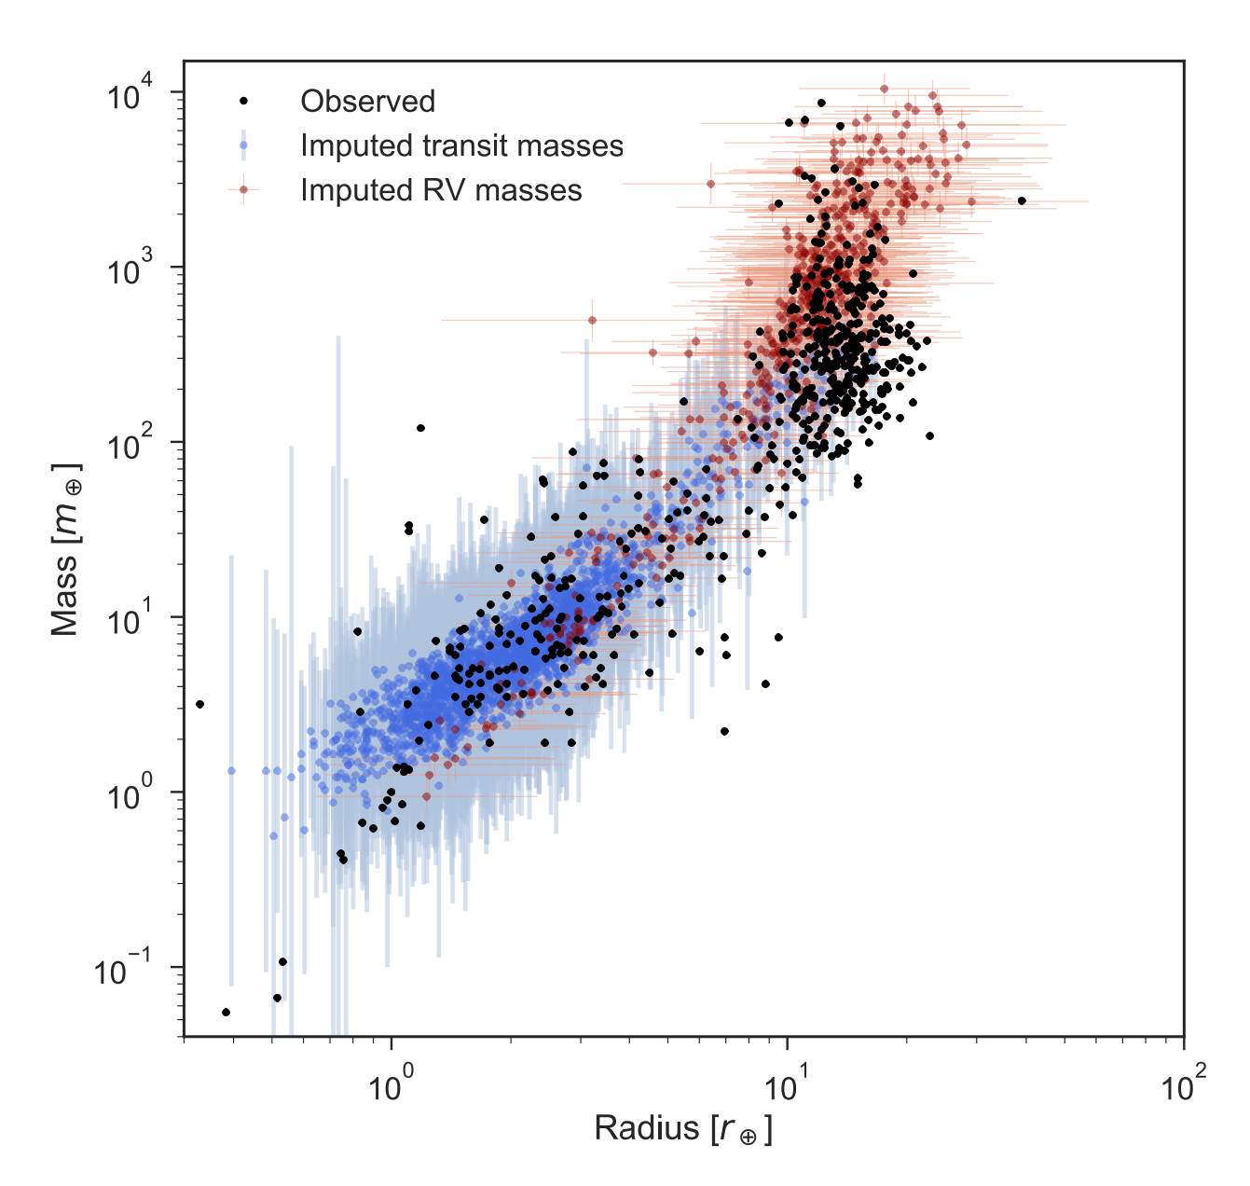
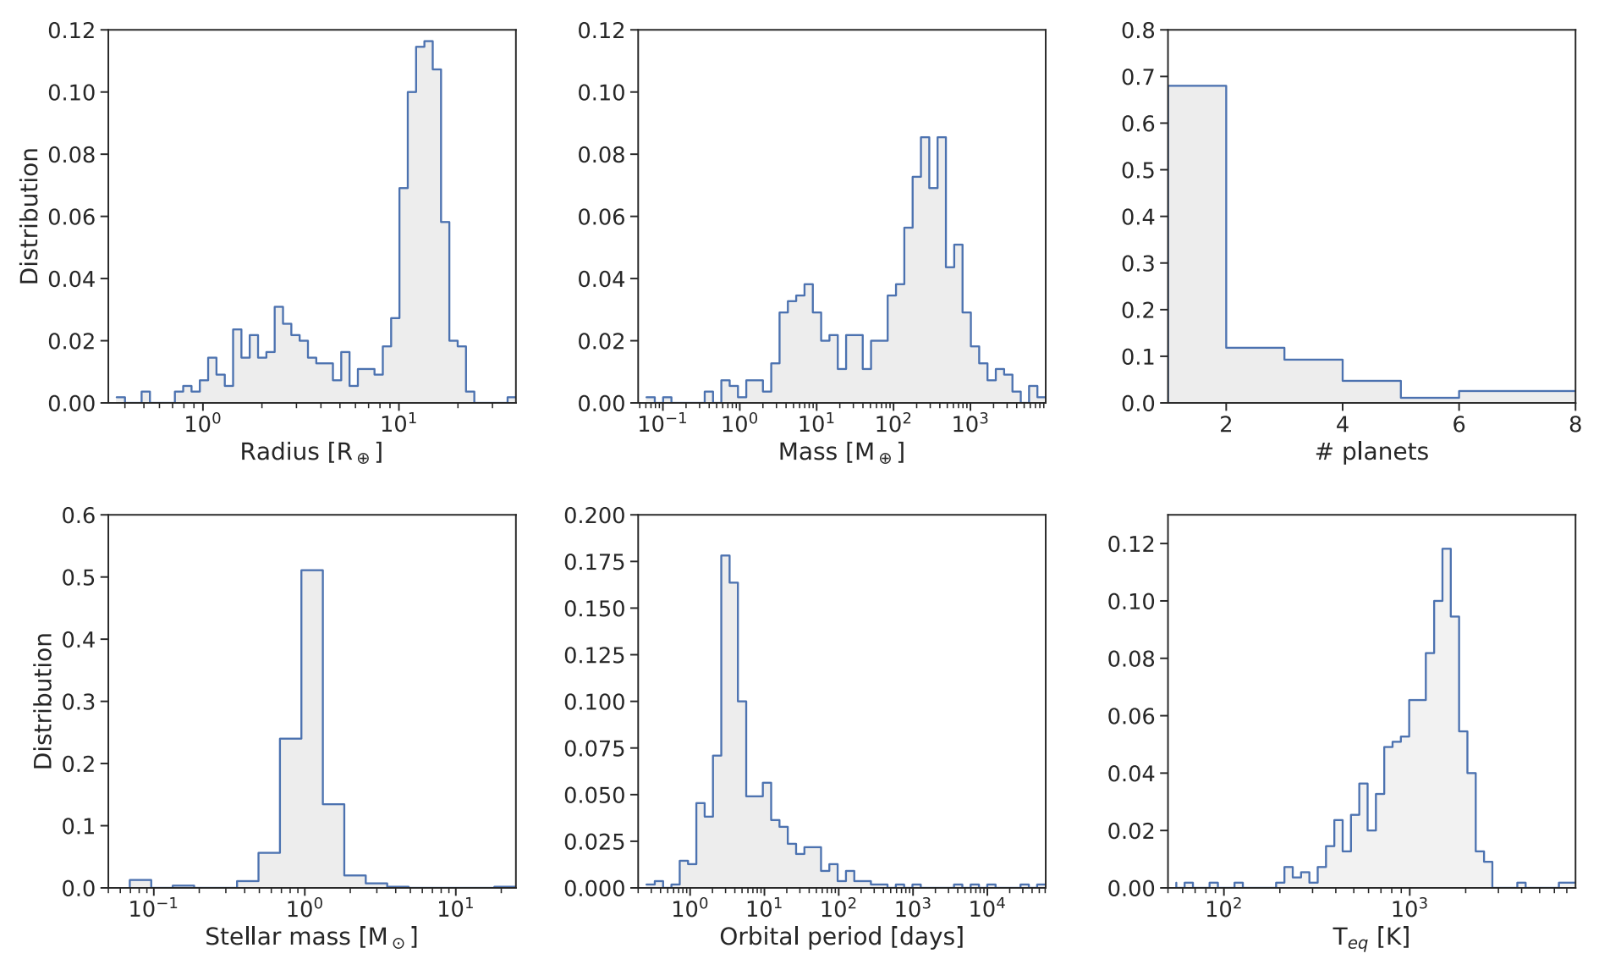
Can exoplanetary Mass be estimated with Deep Learning? ( Tasker, Laneuville, & Guttenberg, 2020)
Philosophy: Realist Epistemological
Approach: Inductive
Strategy: Grounded Theory
Choice: Mono-Method
Time-horizon: Cross-Sectional
Data Collection and Analysis:
Data: Observation
Analysis: Statistical
Tool: Neural Network
Known planetary properties (black) and predicted properties (green).
Various observed/derived properties of exoplanets.

Slide 16
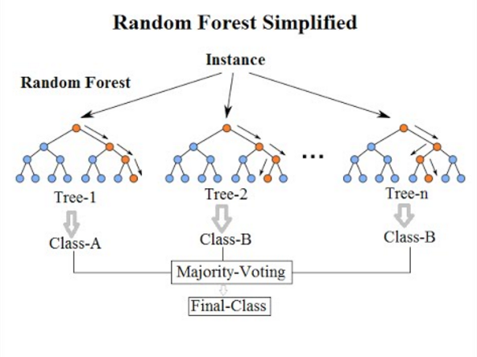


Can machine Learning Predict risk of suicide attempts over time? (Walsh, Rebeiro, & Franklin, 2017)
Philosophy: Positivism
Approach: Inductive
Strategy: Archival Research/Experiment
Choice: Mixed-methods
Time-horizon: Longitudinal
Data Collection and Analysis:
Experiment: Classification
Analysis: Statistical
Tool: R and Python

Slide 17

DO BOYS AND GIRLS RECEIVE DIFFERENT AMOUNT OF PARENTAL SUPPORT, PARENTAL MONITORING, AND TIME SPENT WITH THEIR PARENTS? (Kristjánsson & Sigfúsdóttir, 2009)
Philosophy: Positivist epistemological
Approach: Deductive
Strategy: Survey
Choice: Mixed-methods
Time-horizon: Cross-sectional
Data Collection and Analysis:
Data: National Survey
Analysis: Statistical
Tool: Independent Samples T-Test

Slide 18
References
Kaur, N., & Kumar, K. (2016). Normalization Based K-means Data Analysis Algorithm. International Journal of Advanced Research in Computer Science and Software Engineering, 6.
Peng, Y., Kou, G., Sabatka, A., Chen, Z., Khazanchi, D., & Shi, Y. (2006, October). Application of clustering methods to health insurance fraud detection. In 2006 International Conference on Service Systems and Service Management (Vol. 1, pp. 116-120). IEEE.
Senko, R. (2019). Machine learning for robo-advisors: testing for neurons specialization. Investment Management and Financial Solutions, 205-214.
Xu, S. (2018). Bayesian Naive Nayes classifiers to text classification. Journal of Information Science, 48-59.
Walsh, C. G., Ribeiro, J. D., & Franklin, J. C. (2017). Predicting Risk of Suicide Attempts Over Time Through Machine Learning. Clinical Psychological Science, 5(3), 457–469.
Cai, E. (2014). Machine Learning Lesson of the Day – The “No Free Lunch” Theorem. Retrieved from https://chemicalstatistician.wordpress.com/2014/01/24/machine-learning-lesson-of-the-day-the-no-free-lunch-theorem/
Kristjánsson, Á. L., & Sigfúsdóttir, I. D. (2009). The role of parental support, parental monitoring, and time spent with parents in adolescent academic achievement in iceland: A structural model of gender differences. Scandinavian Journal of Educational Research, 53(5), 481–496. https://doi.org/10.1080/00313830903180786
Huang, Y., Zhou, Q., Koelper, C., Li, Q. and Nie, B. (2020). Are riders of electric two-wheelers safer than bicyclists in collisions with motor vehicles?. Accident Analysis & Prevention, 134, p.105336.
Tasker, E. J., Laneuville, M., & Guttenberg, N. (2020). Estimating Planetary Mass with Deep Learning. The Astronomical Journal, 159(2), 41. https://doi.org/10.3847/1538-3881/ab5b9e

